Slide 1
More on Clustering

Slide 2
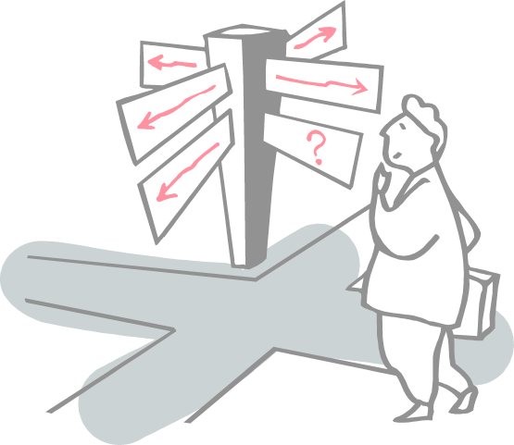
Roadmap
What is the Metric for Clustering?
K-Means Clustering
K-Means++ Clustering
K-Medoids Clustering

Slide 3
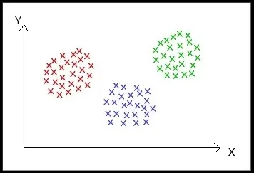
What is the Metric for Clustering?
Clustering is an unsupervised machine learning technique that divides the population or data points into several groups or clusters such that data points in the same groups are more similar to other data points in the same group and dissimilar to the data points in other groups.
Points in the same cluster are closer to each other.
Points in the different clusters are far apart.

Slide 4
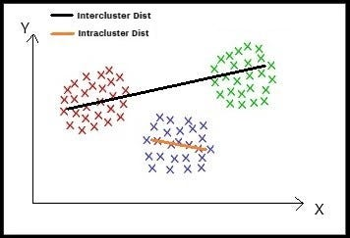
What is the Metric for Clustering?
Clustering is considered to be best if it has maximum intercluster distance and minimum intracluster distance.
Intracluster distance: Distance between two point in the same cluster. Intercluster distance: Distance between two points in the different clusters.

Slide 5

What is the Metric for Clustering?
Dunn Index
The numerator of the above function measures the maximum distance between every two points (x_i, x_j) belonging to two different clusters. This represents the intracluster distance.
The denominator of the above function measures the maximum distance between every two points (y_i, y_j) belonging to the same cluster. This represents the intercluster distance
Clustering having the max value of Dunn-Index is considered to be best.

Slide 6

What is the Metric for Clustering?
Silhouette analysis
This is used to determine the degree of separation between clusters.
For each sample. a_i represents the average distance from all data points in the same cluster.
b_i represents the average distance from all data points in the closest cluster
The coefficient of SA can take values in the interval [-1, 1].
SA = 0: the sample is very close to the neighboring clusters.
SA = 1: the sample is far away from the neighboring clusters.
SA = -1: the sample is assigned to the wrong clusters

Slide 7

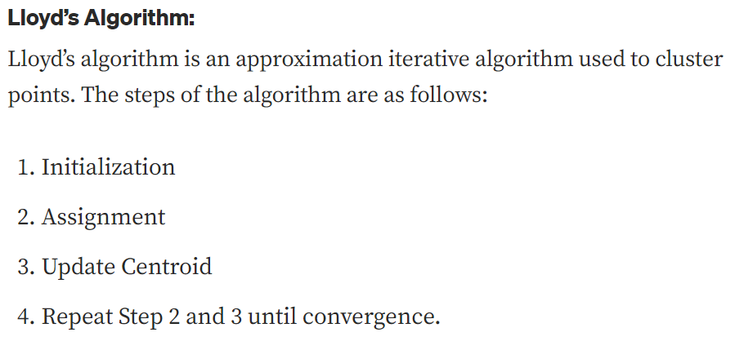
Cost Function of K-Means
The idea of the K-Means algorithm is to find k centroid points (C_1, C_1, . . . C_k) by minimizing the sum over each cluster of the sum of the square of the distance between the point and its centroid

Slide 8
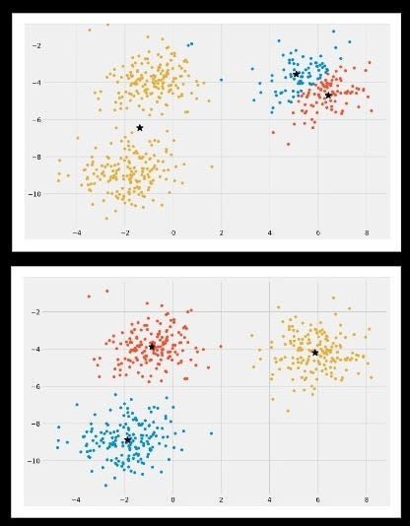
K-Means++ Clustering
In the case of finding initial centroids using Lloyd’s algorithm for K-Means clustering, we were using randomization. The initial k-centroids were picked randomly from the data points.
This randomization of picking k-centroids points results in the problem of initialization sensitivity. This problem tends to affect the final formed clusters. The final formed clusters depend on how initial centroids were picked.

Slide 9
K-Means++ Clustering
There are two approaches to avoid this problem of initialization sensitivity:
Repeat K-means: Repeating the algorithm and initialization of centroids several times and pick the clustering approach that has small intracluster distance and large intercluster distance.
K-Means++: K-Means++ is a smart centroid initialization technique

Slide 10
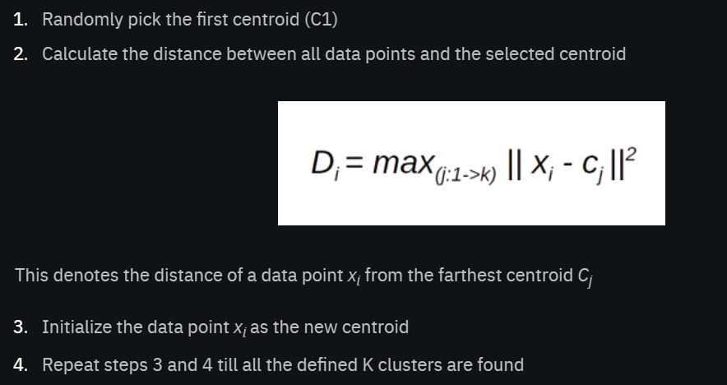
K-Means++ Clustering
K-Means++ is a smart centroid initialization technique and the rest of the algorithm is the same as that of K-Means
https://www.youtube.com/watch?v=efKGmOH4Y_A

Slide 11

K-Medoids Clustering
A problem with the K-Means and K-Means++ clustering is that the final centroids are not interpretable or in other words, centroids are not the actual point but the mean of points present in that cluster.
Here are the coordinates of 3-centroids that do not resemble real points from the dataset
The idea of K-Medoids clustering is to make the final centroids as actual data-points. This result to make the centroids interpretable

Slide 12
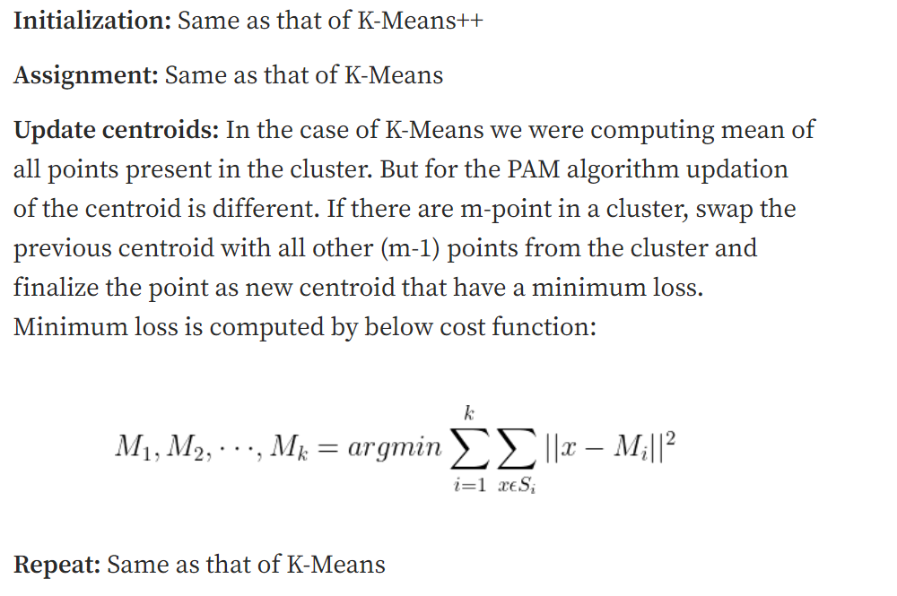
K-Medoids Clustering
The algorithm of K-Medoids clustering is called Partitioning Around Medoids (PAM) which is almost the same as that of Lloyd’s algorithm with a slight change in the update step

Slide 13
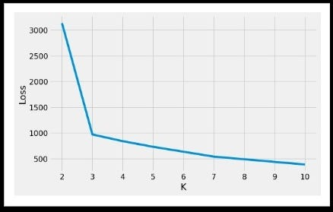

How to pick the best value of K?
minimize intercluster distance and maximize intracluster distance
For the above plot, it is observed that with the increase in the value of ‘k’, loss decreases. To find the best value of ‘k’ as to draw k-clusters, we can pick k=3

Slide 14
References
https://towardsdatascience.com/k-medoid-clustering-pam-algorithm-in-python-with-solved-example-c0dcb35b3f46
https://towardsdatascience.com/understanding-k-means-k-means-and-k-medoids-clustering-algorithms-ad9c9fbf47ca
https://www.youtube.com/watch?v=NyueAYkWqwk

Slide 15
Thanks

